Slide 1


“Sociology is the objective study of human behaviour in so far as it is affected by the fact people live in groups”: Sugarman (“Sociology”, 1968)
“Sociology may be defined as the study of society - the web of human interactions and relationships”: Ginsberg (“The Study of Society”, 1939)
“Sociology is the study of individuals in a social setting…Sociologists study the interrelationships between individuals, organisations, cultures and societies”: Ritzer (“Sociology”, 1979)
“The purpose of Sociology is the scientific study of human society through the investigation of people’s social behaviour”: Giner (“Sociology”, 1972)
What Is Sociology?
“Sociology is the study of human social life, groups and societies. It is a dazzling and compelling enterprise, having as its subject matter our own behaviour as social beings. The scope of sociology is extremely wide, ranging from the analysis of passing encounters between individuals in the street up to the investigation of world-wide social processes”: Giddens (“Sociology”, 1989)
“Sociology is the study of individuals in groups in a systematic way, which grew out of the search for understanding associated with the industrial and scientific revolutions of the 18th and 19th centuries”: Lawson and Garrod (“The Complete A-Z Sociology Handbook”, 1996)

Slide 2
Two major themes
Examples
Identify some of the things sociologists study
Identify some of the ways sociologists study social life

Slide 3
Two major themes
Identify some of the things sociologists study
Identify some of the ways sociologists study social life
Sociologists study social behaviour - people and their patterns of behaviour. The focus is on the way people form relationships and how these relationships, considered in their totality, are represented by the concept of a “society”.
The definitions included words like “scientific”, “systematic” and “objective” - ideas that tell us something about how sociologists study behaviour and the kinds of knowledge they are trying to produce to explain such behaviour.
Sociologists create knowledge that is factual, rather than simply based on opinion. Systematic ways of studying social behaviour are used - sociologists test their ideas about social behaviour using evidence drawn from their observations.
The focus of attention is group behaviour – how the groups people join or are born into (family, work, education and so forth) affect their development and behaviour.

Slide 4
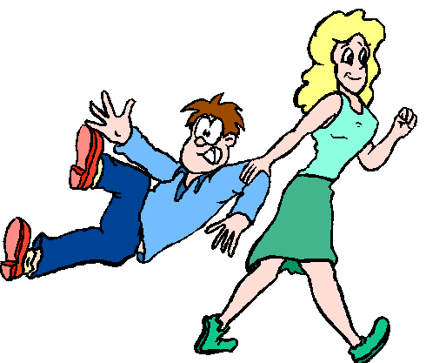
“Sociology is a social science concerned with the study of social relationships and the various ways these relationships are patterned in terms of our membership of social groups”.
This being the case, we need to look a little more closely at the concepts of social groups in order to understand how the relationships we form shape our behaviour…

Slide 5





A Friendship Group
Includes people who hang around together because they like each other
A Work Group
Might include people who do the same type of job.
A “social group” is a collection of individuals who interact – both formally and informally – with each other.
A Peer Group
Includes people of roughly the same age
An Educational Group
Might include people studying together in the same school / college or class.
A Family Group
People who are related by birth, marriage, etc.

Slide 6
Social Groups…
Our relationships are based on (or structured by) both formal and informal rules. “Society” therefore, represents a totality of relationships that imposes rules upon our behaviour.
Structure
Society
The largest group to which we usually belong…
Institutions
Small Groups
Individuals
Action
Groups, such as families, peer and friendship groups, etc.
Institutions are stable patterns of group behaviour that persist over long periods of time
The main types of institutional groups in our society are:
Family and Kinship, Government, Work and cultural institutions such as the media, education, and religion.

Slide 7

That is, the way our individual lives are built around social relationships and the rules we have developed to govern such relationships.
One of the main things sociologists investigate are “social structures”
Sociologists argue that our individual choices of behaviour are shaped by the relationships we form (or have imposed on us).
In the following screens, therefore, we need to investigate some of the ways our behaviour is constrained, formally and informally, by social structures…

Slide 8
Identify some of the ways your behaviour is influenced by:
Society
The Media
Language…
Lifestyle
Laws
Advertising

Slide 9
Identify some of the ways your behaviour is influenced by:
School
Your Family
Respect for authority
Right and wrong behaviour
What you are taught
Language

Slide 10
Identify some of the ways your behaviour is influenced by:
Your Peers
Your Friends
Fashion
Self-perception
Gender behaviour

Slide 11


If Sociology is the study of social relationships and the way in which our lives are structured by rules, it follows that the initial answer to the question
“What is Sociology?”
is that it is the study of Social Order…
In other words, Sociology explains how order is:
Created
Maintained
Reproduced
This being the case, the next step is to examine these ideas, beginning with the concept of culture…

