Slide 1
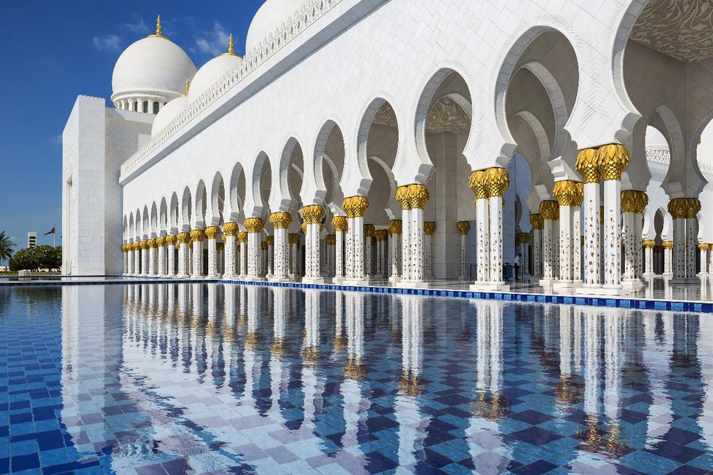
Some Functions of Culture
Notes:
Photo by WanderingtheWorld (www.ChrisFord.com) - Creative Commons Attribution-NonCommercial License https://live.staticflickr.com/1283/4663275780_dabe062123_b.jpg

Slide 2
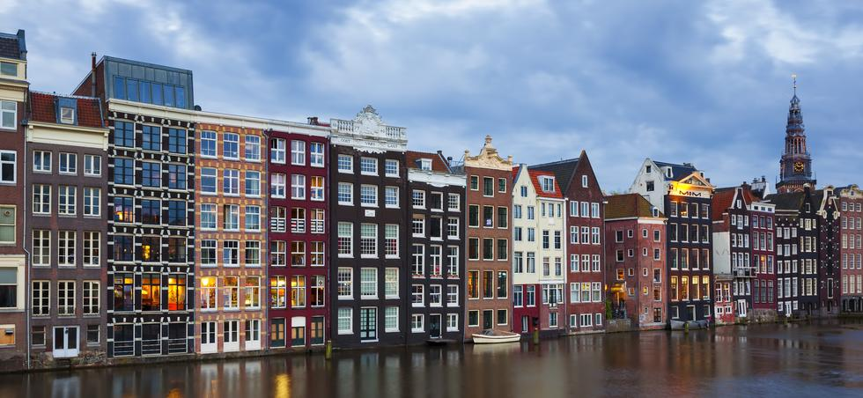
Some Functions of Culture
Communication
Perception
Identity
Value Systems
Motivation
Stratification
Production and Consumption
End Presentation
Notes:
Photo by WanderingtheWorld (www.ChrisFord.com) - Creative Commons Attribution-NonCommercial License https://live.staticflickr.com/1283/4663275780_dabe062123_b.jpg

Slide 3
Some Functions of Culture
Communication
Perception
Identity
Value Systems
Motivation
Stratification
Production and Consumption
End Presentation
Culture provides the context for the development of human communication systems such as language.
Notes:
Photo by WanderingtheWorld (www.ChrisFord.com) - Creative Commons Attribution-NonCommercial License https://live.staticflickr.com/1283/4663275780_dabe062123_b.jpg

Slide 4
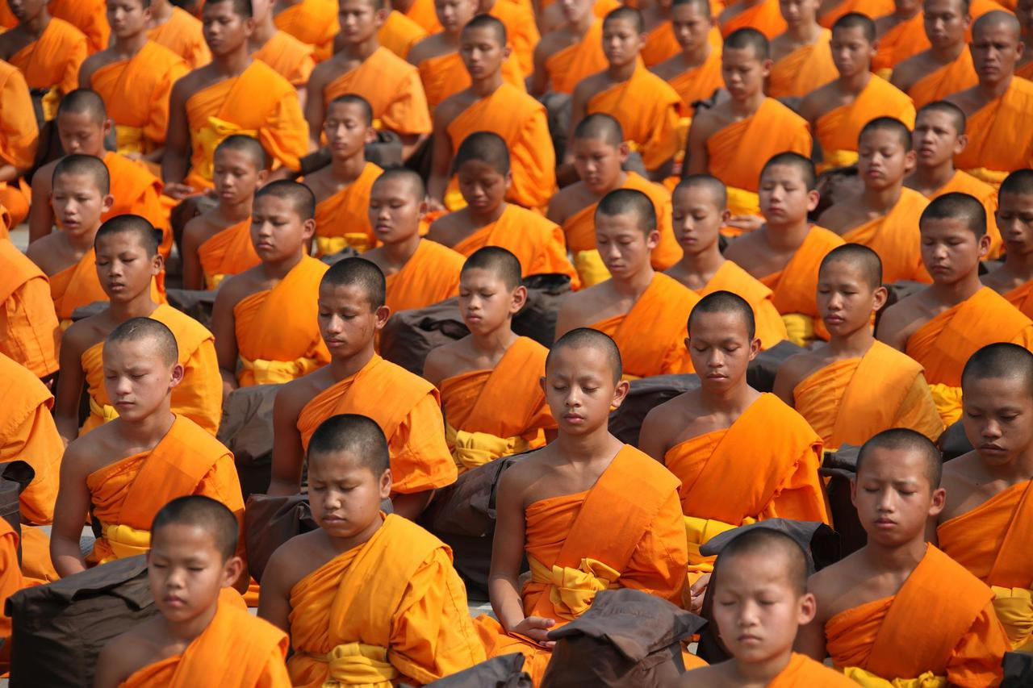
Some Functions of Culture
Communication
Perception
Identity
Value Systems
Motivation
Stratification
Production and Consumption
End Presentation
Culture shapes how we see and understand
the social and natural worlds.
Notes:
Photo by WanderingtheWorld (www.ChrisFord.com) - Creative Commons Attribution-NonCommercial License https://live.staticflickr.com/1283/4663275780_dabe062123_b.jpg

Slide 5
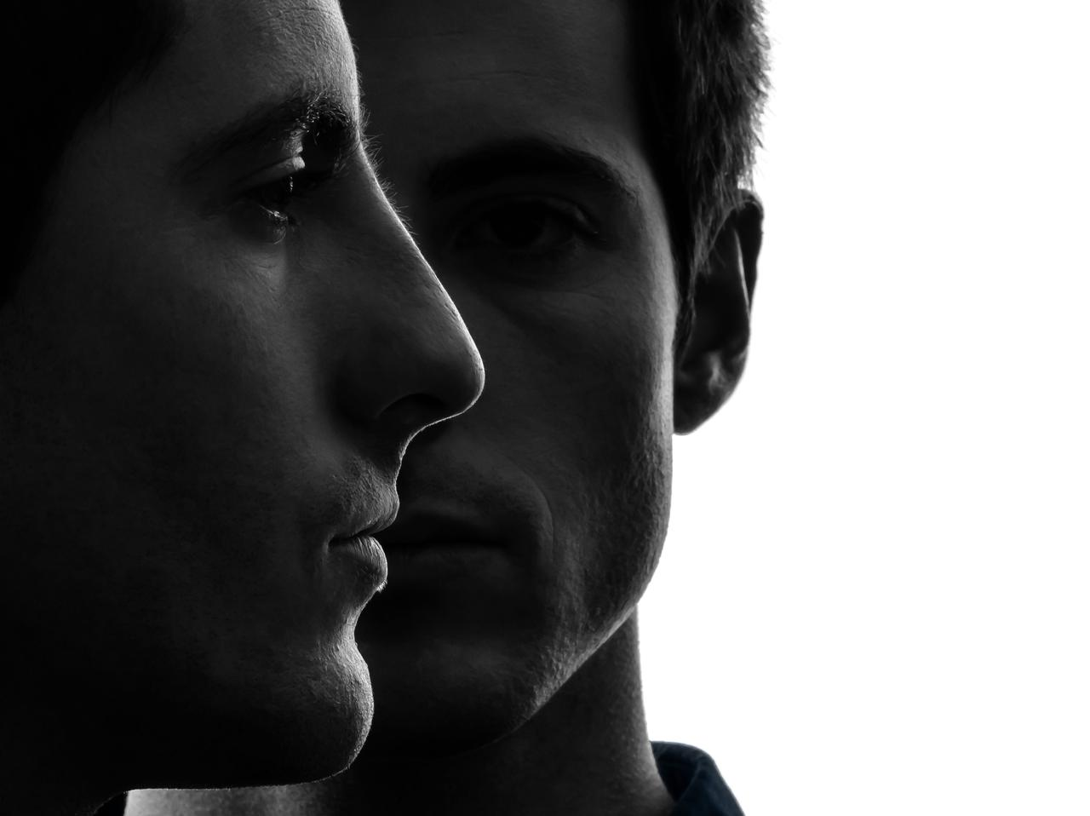
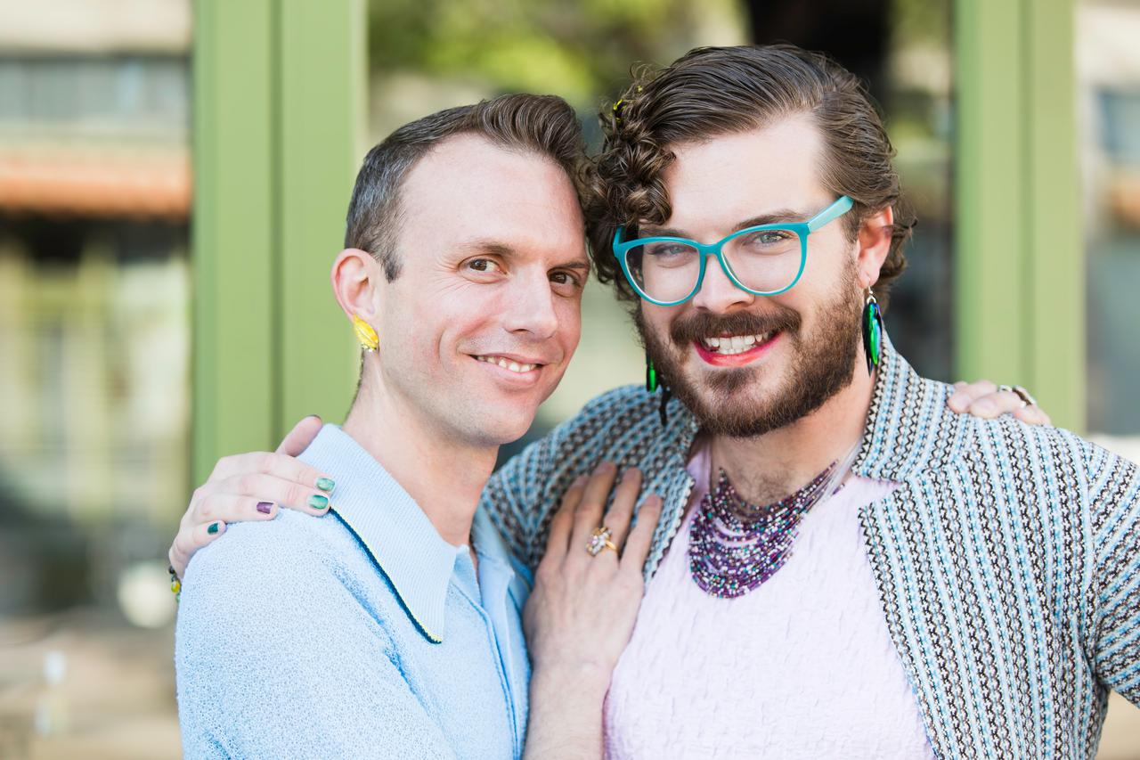
Some Functions of Culture
Communication
Perception
Identity
Value Systems
Motivation
Stratification
Production and Consumption
End Presentation
Culture influences how people see themselves and others, in terms of ideas like class, age, gender, ethnicity, nationality, sexuality…
Notes:
Photo by WanderingtheWorld (www.ChrisFord.com) - Creative Commons Attribution-NonCommercial License https://live.staticflickr.com/1283/4663275780_dabe062123_b.jpg

Slide 6
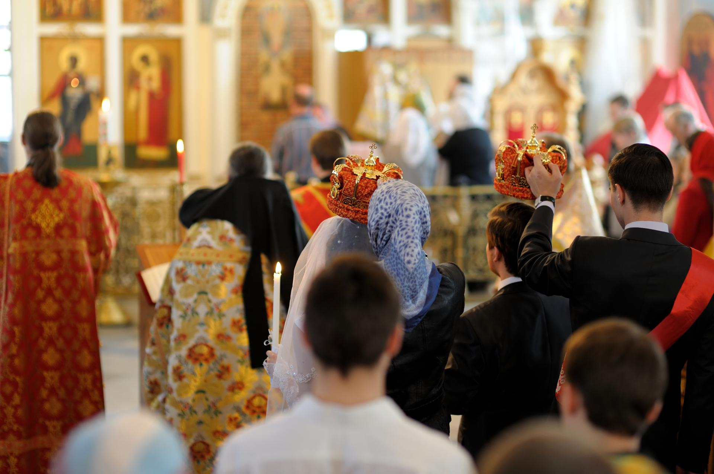
Some Functions of Culture
Communication
Perception
Identity
Value Systems
Motivation
Stratification
Production and Consumption
End Presentation
Cultural institutions (families, education, religion…) are a major
source of the values into which people are socialisaed.
Notes:
Photo by WanderingtheWorld (www.ChrisFord.com) - Creative Commons Attribution-NonCommercial License https://live.staticflickr.com/1283/4663275780_dabe062123_b.jpg

Slide 7
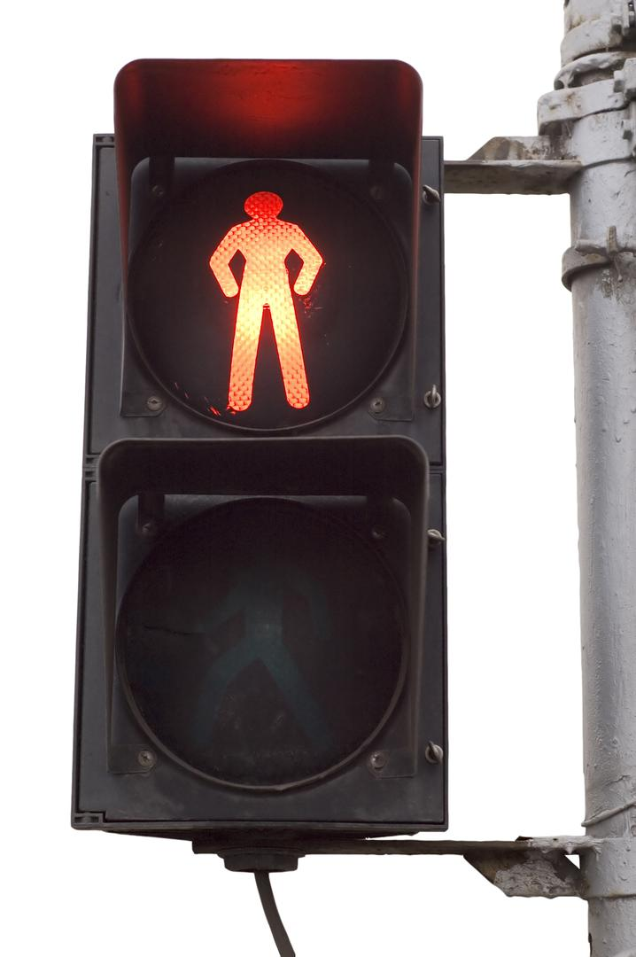
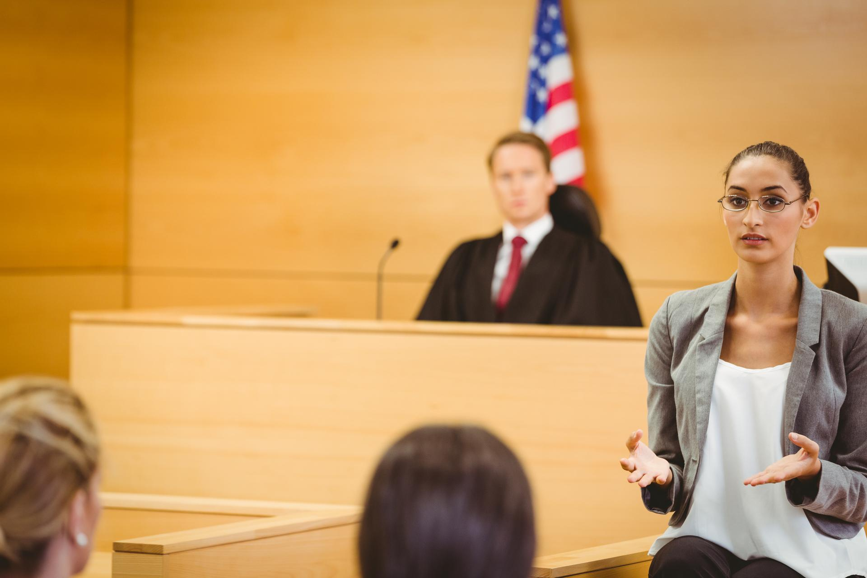
Some Functions of Culture
Communication
Perception
Identity
Value Systems
Motivation
Stratification
Production and Consumption
End Presentation
Cultural values and norms motivate people to conform through sanctions (rewards and punishments) for particular behaviours. Laws also motivate conformity by setting acceptable behavioural boundaries..
Notes:
Photo by WanderingtheWorld (www.ChrisFord.com) - Creative Commons Attribution-NonCommercial License https://live.staticflickr.com/1283/4663275780_dabe062123_b.jpg

Slide 8
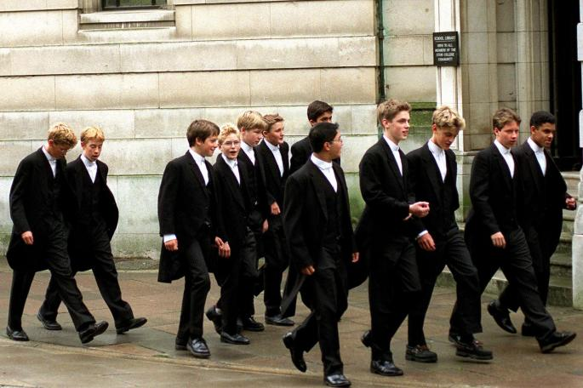
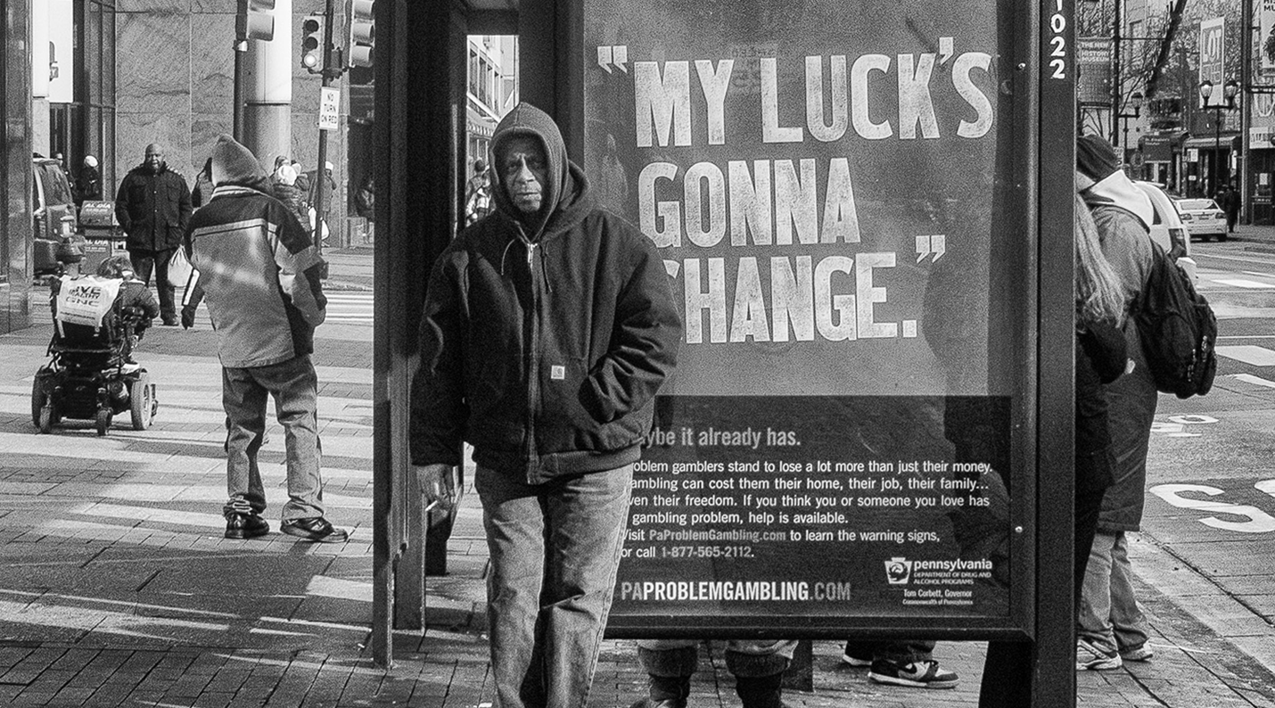
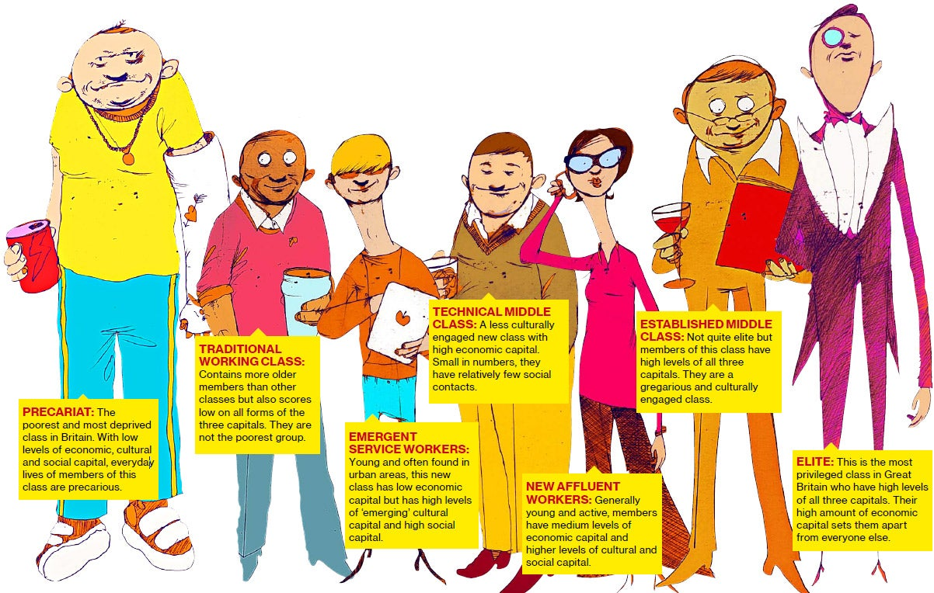
Some Functions of Culture
Communication
Perception
Identity
Value Systems
Motivation
Stratification
Production and Consumption
End Presentation
All cultures develop ways of differentiating between social groups on the basis of ideas like class (economic divisions), rank (political divisions), gender, age and the like.
Notes:
Photo by WanderingtheWorld (www.ChrisFord.com) - Creative Commons Attribution-NonCommercial License https://live.staticflickr.com/1283/4663275780_dabe062123_b.jpg

Slide 9
Some Functions of Culture
Communication
Perception
Identity
Value Systems
Motivation
Stratification
Production and Consumption
End Presentation
Culture defines what people “need, use and value”. They need, for example, to be organised and motivated to work (production) and they need to be encouraged to consume the products of work…
Notes:
Photo by WanderingtheWorld (www.ChrisFord.com) - Creative Commons Attribution-NonCommercial License https://live.staticflickr.com/1283/4663275780_dabe062123_b.jpg

Slide 10
Some Functions of Culture
Shortcutstv
shortcutstv.com
Notes:
Photo by WanderingtheWorld (www.ChrisFord.com) - Creative Commons Attribution-NonCommercial License https://live.staticflickr.com/1283/4663275780_dabe062123_b.jpg

