Slide 1

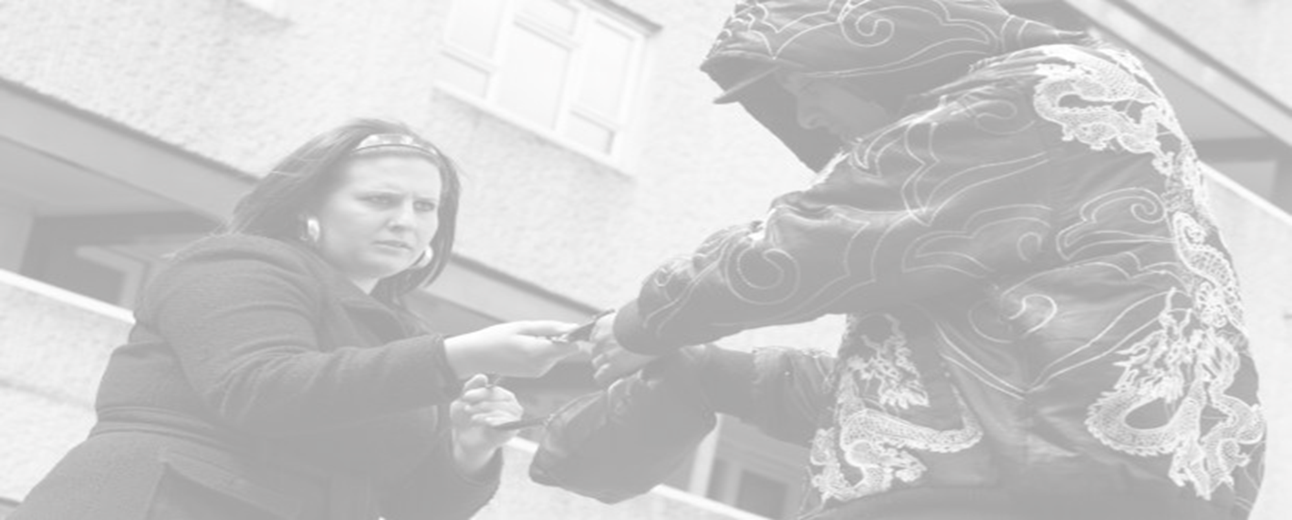

Visualising
Left Realism
Shaping our Understanding of Crime

Slide 2
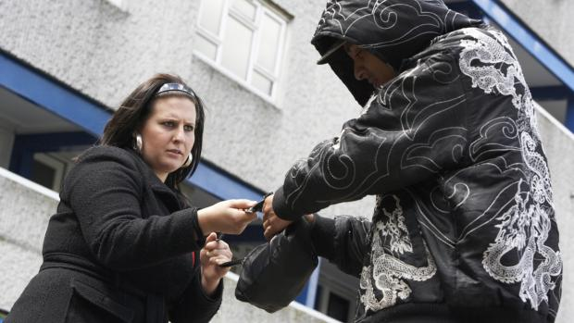
Visualising
Back
Left Realism
Offender
Victim
Social Reaction
Three-Cornered Approach to Crime (Young,2003)

Slide 3
Visualising
Back
Left Realism
Relative Deprivation
Political Marginalisation
Subcultural
Support
The Criminogenic Triangle (Lea and Young, 1984)

Slide 4
Visualising
Back
Left Realism
Police / Agencies
(Formal Control)
Offender
The Public
(Informal Control)
Victim
The Square of Crime (Young,1997)

