Slide 1
Pluralist model of power
Where does power reside
in modern Britain?

Slide 2
Define ‘Power’

Slide 3
Some quotes…
The term “power” comes from the Latin posse: to do, to be able, to change, to influence or effect. To have power is to possess the capacity to control or direct change. All forms of leadership must make use of power. The central issue of power in leadership is not Will it be used? But rather Will it be used wisely and well?
Violence is not power, but the absence of power.
The thing women have yet to learn is nobody gives you power. You just take it.
If those in charge of our society - politicians, corporate executives, and owners of press and television - can dominate our ideas, they will be secure in their power. They will not need soldiers patrolling the streets. We will control ourselves.
He who pays the piper calls the tune.

Slide 4
Power corrupts, and absolute power corrupts absolutely.
Arbitrary power is like most other things which are very hard, very liable to be broken.
A friend in power is a friend lost.
Power is not only what you have but what the enemy thinks you have.
But the relationship of morality and power is a very subtle one. Because ultimately power without morality is no longer power.
We thought, because we had power, we had wisdom.
Power intoxicates men. When a man is intoxicated by alcohol, he can recover, but when intoxicated by power, he seldom recovers.

Slide 5
Draw a diagram to show where power resides in either:
Your family
The school
England

Slide 6
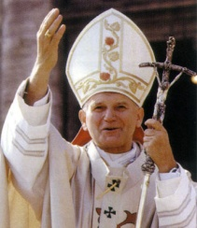
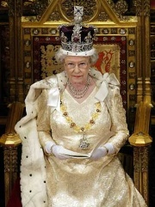
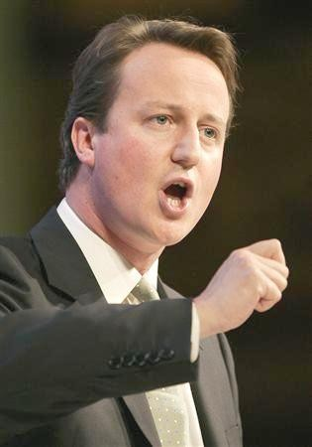
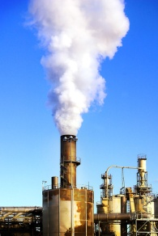

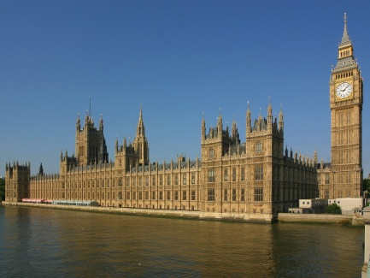

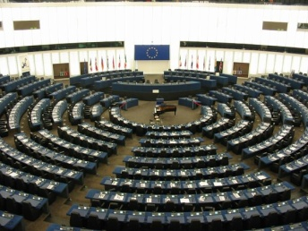

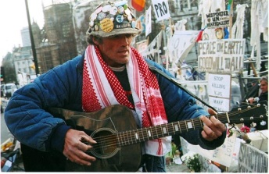
Royal assent
Bill debated
Act of Parliament.
Desire for change

Slide 7
Bourgeoisie
Royal assent
Bill debated
Act of Parliament.
Desire for change

