Slide 1
Designed for
Sociology (8192)
Specification contents covered in this learning session: Functions of Families
Content
Differing views of the functions of families.
Parsons functionalist perspective on primary socialisation and the stabilisation of adult personalities.
Additional information
Students should be able to:
Identify, describe and explain the functions of families (sexual, reproductive, economic and educational)
Describe, compare and contrast a variety of sociological perspectives on the functions of families (functionalist, feminist and Marxist).
Copyright Adam Godwin (2017)
Notes:
Copyright Adam Godwin (2017)

Slide 2
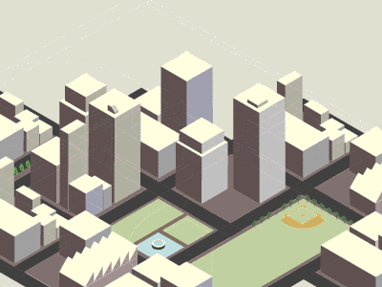
What would we have to change in order to create a society in which all children have a happy family life?
If this happened, what would society be like?

Slide 3
Title: The Functions of the Family
All students...
Sunday, 15 November 2020
Must
Describe the meaning of key-terms
Should
Outline & explain differing sociological views about the functions of the family
Could
Analyse & central sociological debates
Write the title and date (always underline these)
Read the learning objectives
Create a mind-map showing how families function to support wider society…
Notes:
Create a list of questions… Create a list…

Slide 4
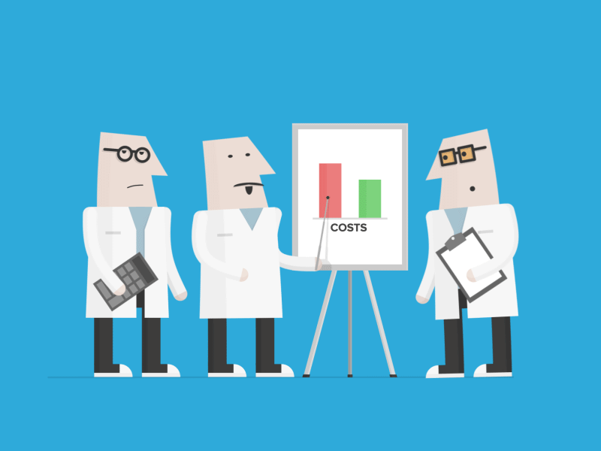
Key Information
Functionalists view the main purpose of the family is:
Socialising the young (primary socialisation)
Providing stability and meaning for adults
Other functions include the:
Reproductive – families provide a good context for creating and raising children in a stable environment.
Sexual – families allow men and women to control and limit the sexuality of their partner: ensuring the legitimacy of children and the stability of the family.
Educational – families help to educate children
Economy – families prepare children for their role in a capitalist economy and in wider society. (Marxists are interested in this aspect the most!)
Feminists are interested in how families socialise gender roles in children.
Summarise this information, before the time runs out, in the form of a single sentence

Slide 5
Match the key-word with their definitions!
1
A
Child rearing
Parsons claimed women's role in the family is to provide care, love, affection, security and all the necessary emotional support a family member might need.
2
B
Economy
The state of a country or region in terms of the production and consumption of goods and services and the supply of money.
3
C
Instrumental role
A continuing process whereby an individual acquires a personal identity and learns the norms, values, behaviour, and social skills.
4
D
Expressive role
The opportunities each individual has to improve his or her quality of life.
5
E
Socialisation
Parsons claimed that the man’s role within the family is the breadwinner: he is the one who earns money and provides material resources.
6
F
Life chances
Raising children
Work alone
Write out the key-words and definitions in full
Work in pairs
Just write the numbers and letters (e.g. 1B, 2CD…)

Slide 6
PUNY EARTHLING! What is the purpose of these things you call “families”?
Write your answer down and be ready to explain it to the class…

Slide 7
Knowledge Hunt!
Marxist sociologists view the family unit as being corrupted by capitalism: natural family roles have been replaced by the need to socialise children for the workplace.
Feminist sociologists view the family as having the function of shaping our gender identities and socialising gender roles,
Use the information around the room to complete your worksheet!

Slide 8
“One thing I learnt so far today…”

Slide 9
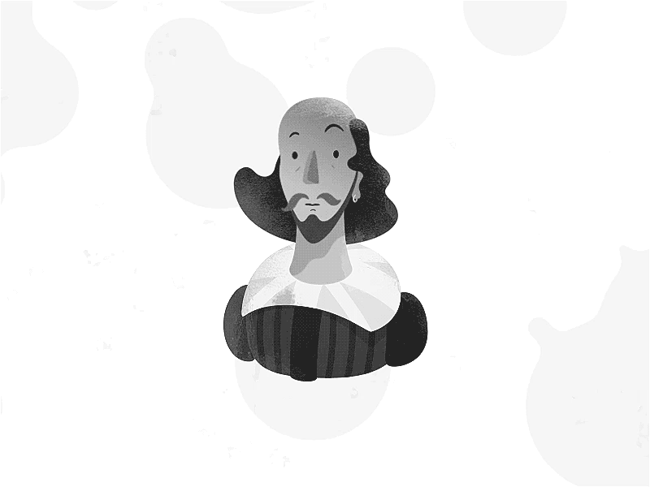
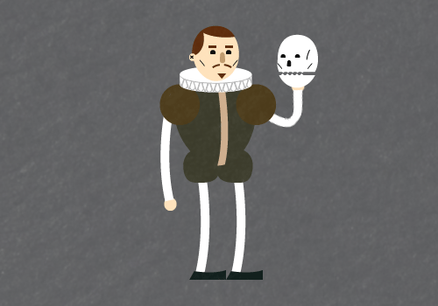
Write a short story, play, or diary entry about the challenges faced by a couple starting a family. Try to explain:
Why they are starting a family
How it will benefit them
How they intend to raise their children so that their children have the best life-chances
How they hope their family will contribute to the community and wider society
What challenges they are concerned about
Learning objective

Slide 10
Place a post-it note in any square!
Two things I would like to know more about...
One thing I know now that I didn’t before...
Two things I will definitely remember...
One thing that surprised me...
Two questions I would like to ask...
One thing I’ll keep thinking about...
One way I could improve my work...
Two sentences that would summarise this lesson...
Notes:
Can be verbal, post-it or personal whiteboard based in feedback method.

Slide 11
Questions for Discussion…
What is the main function of the family?
Is it possible to have a society in which family life is radically different?
How has the function of the family changed over time?

Slide 12
Homework
Create a leaflet showing different views about the function of the family.

Slide 13
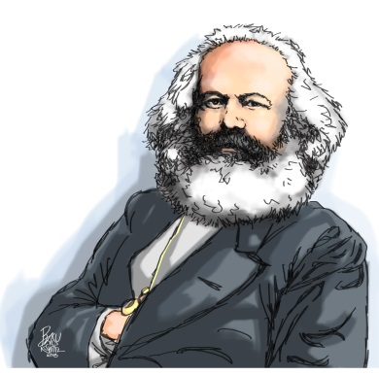
Move to the right or left side of the room based on whether you agree or disagree with the following statement.
AGREE
DISAGREE
“The main function of the family is to socialise young people for their roles as adults.”
Notes:
Use questioning and emphasise the need for students to justify their reasons and use sensible arguments. “What is wrong with the other position in your view?”, “Why did you choose to stand where you’re standing?”, “Why do you think people disagree so much about this question?” are examples of useful questions for this exercise. It is best to encourage students to pick a side rather than float in the middle: but it can also be fun to allow students to change side as the debate progresses, so that sutdents can try to persuade one another to move.

Slide 14
Move to the right or left side of the room based on whether you agree or disagree with the following statement.
AGREE
DISAGREE
“Parents choose to have children, usually, for completely selfish reasons.”
Notes:
Use questioning and emphasise the need for students to justify their reasons and use sensible arguments. “What is wrong with the other position in your view?”, “Why did you choose to stand where you’re standing?”, “Why do you think people disagree so much about this question?” are examples of useful questions for this exercise. It is best to encourage students to pick a side rather than float in the middle: but it can also be fun to allow students to change side as the debate progresses, so that sutdents can try to persuade one another to move.

Slide 15
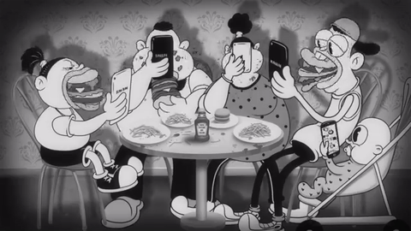
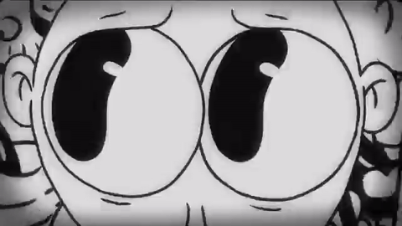
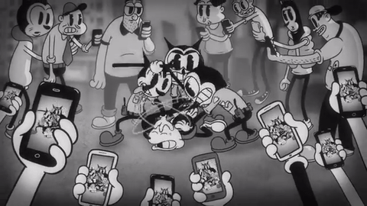
Move to the right or left side of the room based on whether you agree or disagree with the following statement.
AGREE
DISAGREE
“Parsons was right: one of the main functions of the family is to control sexual behaviour of its members.”
Notes:
Use questioning and emphasise the need for students to justify their reasons and use sensible arguments. “What is wrong with the other position in your view?”, “Why did you choose to stand where you’re standing?”, “Why do you think people disagree so much about this question?” are examples of useful questions for this exercise. It is best to encourage students to pick a side rather than float in the middle: but it can also be fun to allow students to change side as the debate progresses, so that sutdents can try to persuade one another to move.

Slide 16
Move to the right or left side of the room based on whether you agree or disagree with the following statement.
AGREE
DISAGREE
“Without healthy functional families, we cannot have a stable society. Families are a functional prerequisite for society.”
Notes:
Use questioning and emphasise the need for students to justify their reasons and use sensible arguments. “What is wrong with the other position in your view?”, “Why did you choose to stand where you’re standing?”, “Why do you think people disagree so much about this question?” are examples of useful questions for this exercise. It is best to encourage students to pick a side rather than float in the middle: but it can also be fun to allow students to change side as the debate progresses, so that sutdents can try to persuade one another to move.

Slide 17
Move to the right or left side of the room based on whether you agree or disagree with the following statement.
AGREE
DISAGREE
“Parents who fail to prepare their children for life as a worker in a capitalist society should have their children taken away from them by social services.”
Notes:
Use questioning and emphasise the need for students to justify their reasons and use sensible arguments. “What is wrong with the other position in your view?”, “Why did you choose to stand where you’re standing?”, “Why do you think people disagree so much about this question?” are examples of useful questions for this exercise. It is best to encourage students to pick a side rather than float in the middle: but it can also be fun to allow students to change side as the debate progresses, so that sutdents can try to persuade one another to move.

Slide 18
Generate an interesting statement to debate as a class and move to the right or left side of the room based on whether you agree or disagree with it.
AGREE
DISAGREE
“_______________________________”
Notes:
Use questioning and emphasise the need for students to justify their reasons and use sensible arguments. “What is wrong with the other position in your view?”, “Why did you choose to stand where you’re standing?”, “Why do you think people disagree so much about this question?” are examples of useful questions for this exercise. It is best to encourage students to pick a side rather than float in the middle: but it can also be fun to allow students to change side as the debate progresses, so that sutdents can try to persuade one another to move.

Slide 19
See you next time!
Notes:
Copyright Adam Godwin (2017)

Slide 20
Save time, click anywhere to download more of GODWIN86’s GCSE Sociology Resources!
This lesson (and the associated learning materials) is copyrighted by Adam Godwin (2017) ‘Godwin86’
Animation courtesy of Nicola Gastaldi (gasta.org)
Copyright Notice Images used in these resources are used under ‘Fair Use’ guidelines. All lessons are made so as to contribute to the British education system and with the public good in mind. We express gratitude to those listed below and other sources who have helped make this resource so beautiful.
Notes:
Copyright Adam Godwin (2017)

