Slide 1
Classic
Psychological
Studies
ShortCutstv
2. Ainsworth
and Bell (1969)
presents

Slide 2
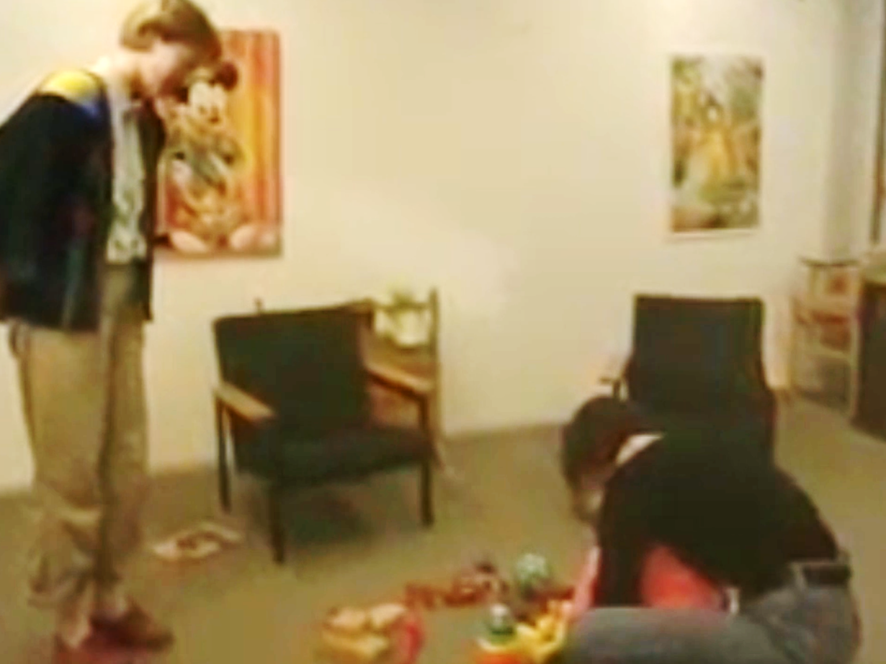
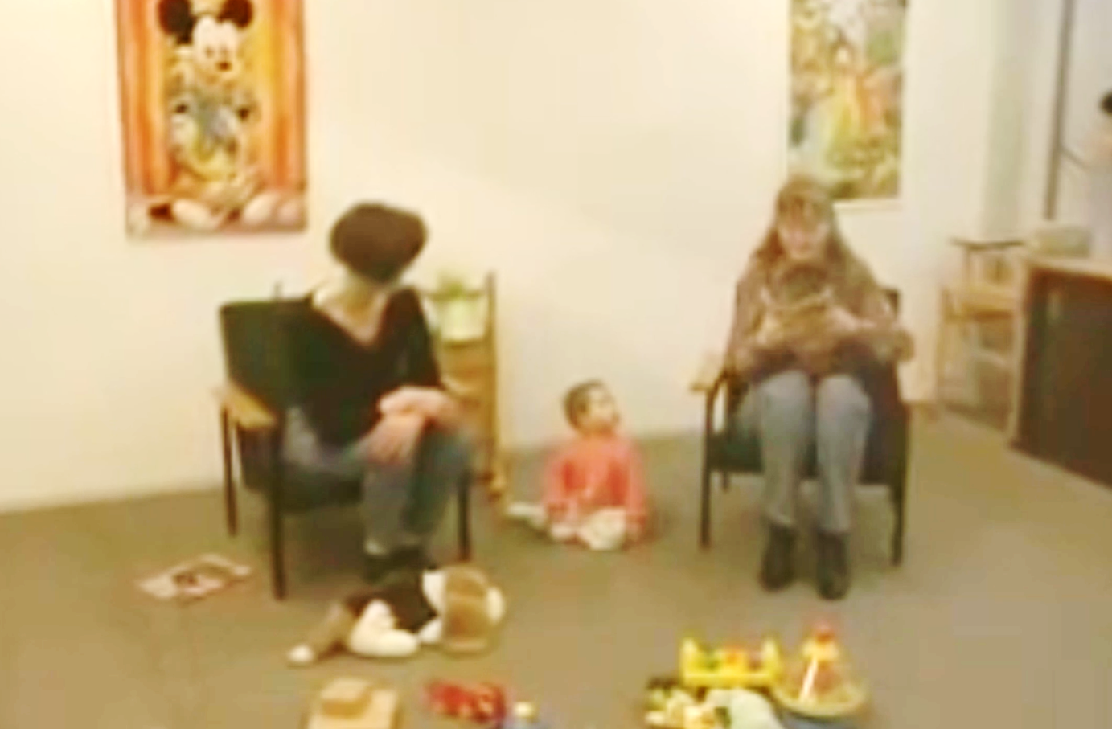
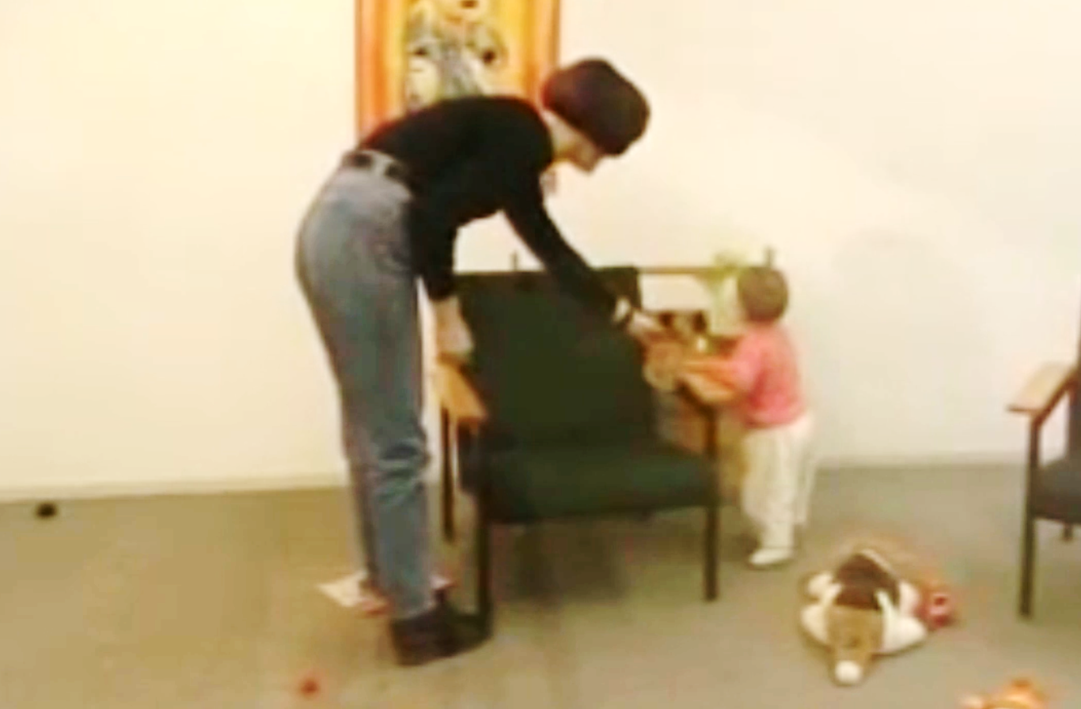
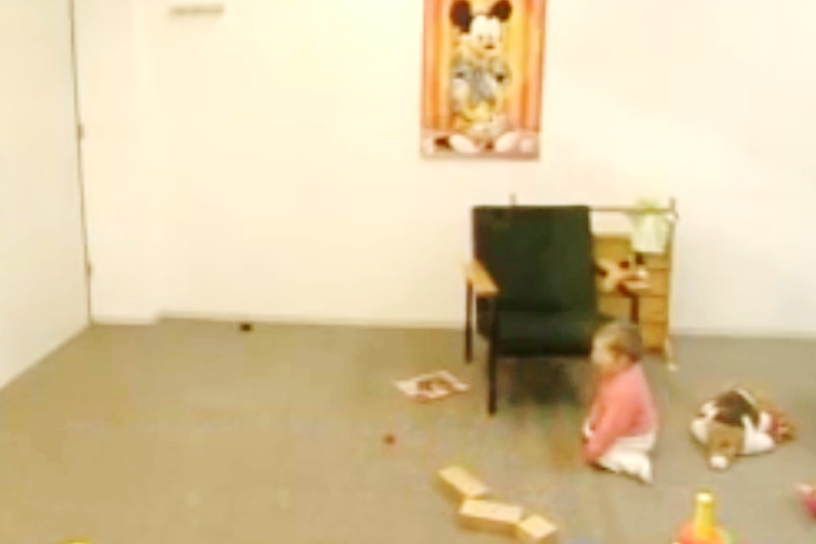
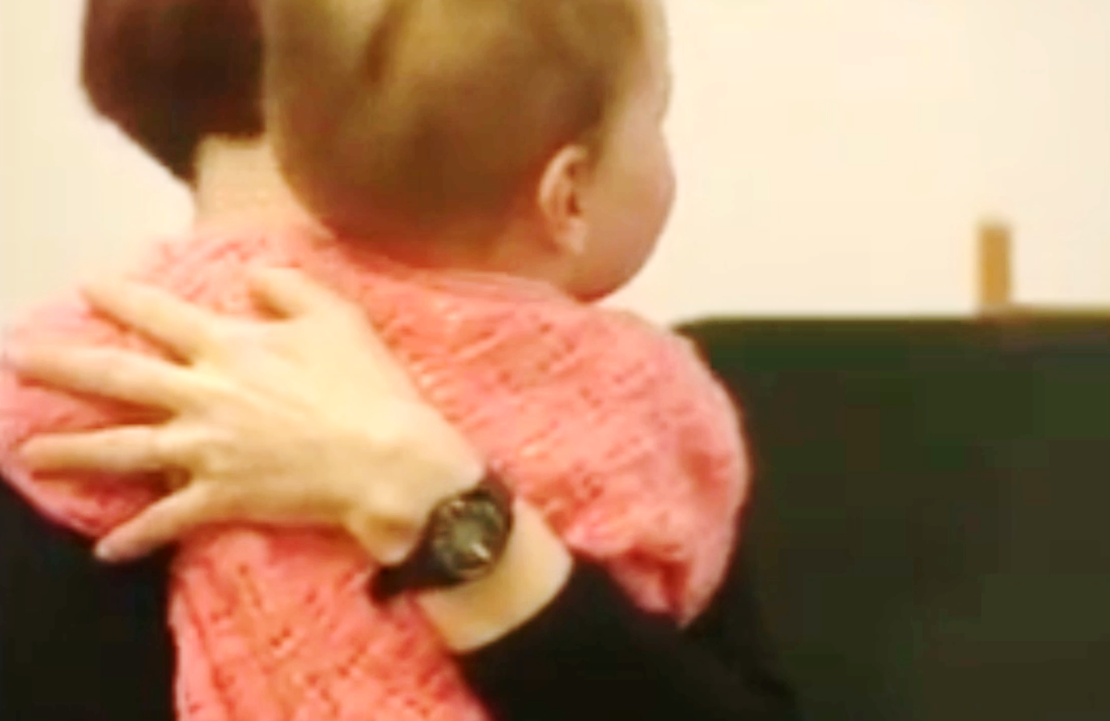
The Strange Situation
Aim
Procedure
Findings
Conclusions
Evaluation

Slide 3
Aim
To describe and assess the attachment (a relatively enduring emotional bond to a specific person. relationship between caregiver and infant

Slide 4
Procedure
Observer shows caregiver and infant into the experimental room and then leaves
Caregiver sits and watches child play
Stranger enters, silent at first, then talks to caregiver, then interacts with infant. Caregiver leaves the room
First separation.
Stranger tries to interact
with infant
First reunion.
Caregiver comforts child, stranger leaves. Caregiver then leaves
Second separation.
Child alone
Stranger enters and tries to interact with child
Second reunion.
Caregiver comforts child, stranger leaves
Play The
Strange Situation
Notes:
Click on picture to reveal text relating to that image.
Click on picture again to reveal next picture etc.
If you want to play a short, two-minute, video illustrating the strange situation process, click on the final picture (number 8) to reveal a button (“Play the Strange Situation”) that, once clicked, will start the video.

Slide 5
Findings
Type of Attachment
Description
Mother’s Behaviour
Upset, subdued when mother leaves.
Happy on reunion. Avoidant of stranger when mother not there, but OK when present
Secure
70% of sample
Sensitive and Responsive.
Child feels positive and loved.
Insecure Avoidant
20% of sample
Unconcerned by mother’s absence. Unresponsive on return. Strongly avoidant of mother and stranger.
Unresponsive.
Child feels unloved and rejected.
Intense distress on separation.
Fear of stranger.
Clingy and rejecting on return.
Insecure Resistant
10% of sample
Inconsistent.
Child feels angry and confused.
Notes:
Click on each type of attachment to reveal “description” (1st click) and “Mother’s behaviour (2nd click)

Slide 6
Conclusions
The primary caregiver’s behaviour determines the attachment style of the child.
A sensitive primary caregiver leads to a securely attached child.
Insecure attachment will lead to problems in later life.
Notes:
Click on each picture to reveal conclusion

Slide 7
Evaluation
Strengths
Weaknesses
The Strange Situation is a standardised procedure. It has been replicated many times.
The measurement of attachment is based on more then one behaviour (e.g. several separations and reunions).
Early identification of attachment problems could mean earlier intervention and the prevention of later problems.
The Strange Situation lacks ecological validity precisely because it is a ‘strange situation’ to the child.
There are cultural variations in child rearing techniques and this study was originally based on an American sample.
Ethical Issues: Distressing for the child and caregiver.
Notes:
Click on Strengths to reveal each strength (i.e. click on strengths 3 times to reveal 3 pieces of information in turn).
Click on Weaknesses to reveal each weakness (i.e. click on weaknesses 3 times to reveal 3 pieces of information in turn).

Slide 8
ShortCutstv
shortcutstv.com

