Slide 1
Right Realism
Vs.
Edgework

Slide 2
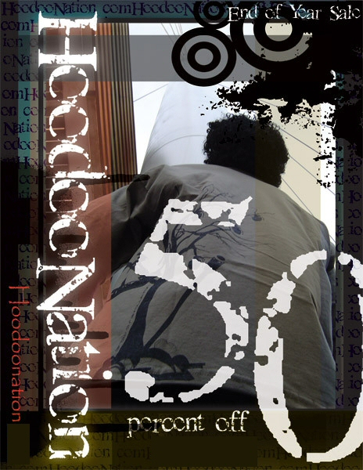
Right Realism
Wilson and Kelling

Slide 3
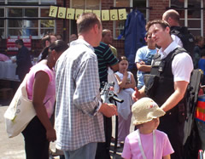
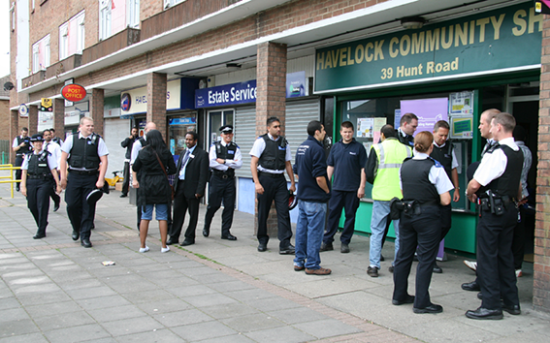
Right Realism

Slide 4
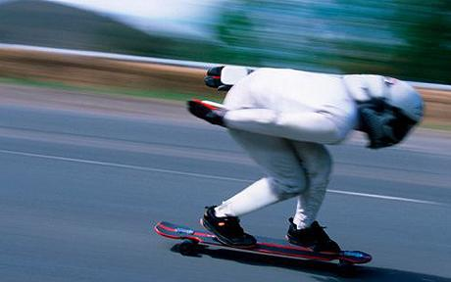
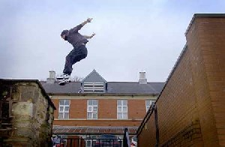
Edgework
“A desire to escape from the institutional order of
contemporary life”
Stephen Lyng

Slide 5
Edgework
Rewards
Psychological
Sociological
Challenge
Control
Power
Overcome
Fear
Self-confidence

Slide 6
Edgework

Slide 7
Edgework
Increasing potential costs…
Increases potential risks…
Making crime more exciting and attractive…

Slide 8
Right Realism
Vs.
Edgework
© www.onlineclassroom.tv (2009)

